Slide 1
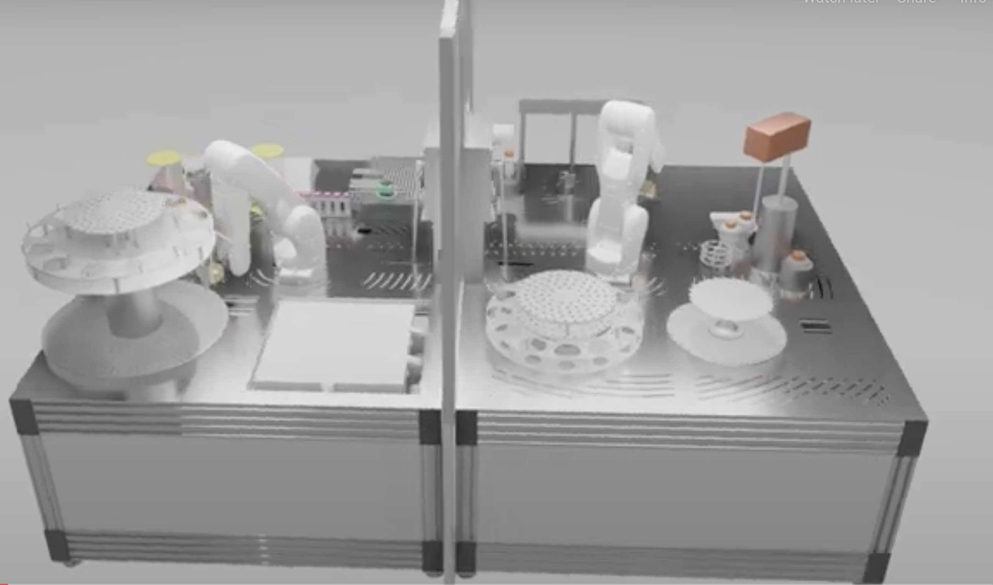
Automated Cellular Robot-Assisted Technologies for translation of discovery-led research in Osteoarthritis
reprogramming
Human Induced Pluripotent
stem cells (hiPSC)
In-line testing by automated,
robotic manufacturing system: large batches of regulatory-compliant cells and cell products
Next-Generation Therapeutics
Osteoarthritis
Cartilage Repair
Differentiation
Automated Production
hiMSC
osteoarthritis
hiCHOs
Cartilage repair
hiMSC - EVs
hiCHO - EVs
AutoCRAT has received funding from the European Union’s Horizon 2020 research and innovation programme under grant agreement no. 874671.

